Slide 1






Layered Curriculum
Chris Belyeu
chbelyeu@oru.edu

Slide 2




Guiding thoughts
  One size does not fit all!
  Every student deserves a special, individualized education.

Slide 3

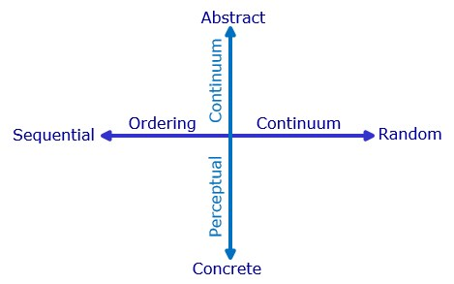



Mind Style
Anthony Gregorc
  Concrete sequential
  Concrete random
  Abstract sequential
  Abstract random
Notes:
Perceptual Preferences
Concrete - 5 senses; what is obvious, no hidden meanings
Abstract - understand ideas, qualities and concepts that cannot be seen; intuition and imagination
Ordering Preferences
Sequential - organization of information in linear, step-by-step manner. Logical train of thought.
Random - organize in chunks with no specific order necessary, skips steps and still produces desired results.

Slide 4




Your Average Class
32 students in an average class
  4 on an IEP
  4 need to be on an IEP
  8 visual learners
  7 auditory learners
  18 tactile learners
Most teachers are visual/auditory learners

Slide 5
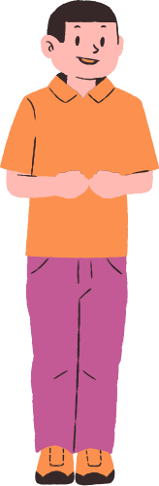






The Problem

Slide 6



Layered Curriculum
Create a whole-class curriculum with modification that has potential to individualize learning for all of the students in your classroom.

Slide 7





3 - Big world questions, critical analysis, and leadership decision making skills
What are the Layers?
2 - Play, manipulate, and hook new knowledge
1 - Knowledge bank, facts, and skills

Slide 8






Layer 1 (C Layer)
Highest grade a student can receive by working solely in this layer is the grade of a “C”.
All students begin at this layer and work their way up, providing students with a general understanding of the topic.
Students collect fatual information in a learning style, reading level, and language that is most comfortable.

Slide 9
Layer 1 (C Layer)
  Usually 12-16 assignments.
  Set a minimum number of points possible for this section.
  Accommodate different learning styles
    Visual - textbook readings, question pages, videos to watch, or periodicals
    Auditory - recorded lectures or audio books, discussion groups, videos
    Tactile - art posters, models, clay sculptures, drawings, online games, flash cards, vocabulary string boards, mobiles, bulletin boards, dioramas

Slide 10
Layer 1 (C Layer)
  Grading C Layer
    Oral Defense - becomes main facilitation role of the teacher and will make the bulk of classroom time during this unit.
    Student verbally “proves” that they have learned the information through sample question response, open discussion, and/or clarifying questions
    Points are provided for learning, not doing
    Share the grading criteria up front if at all possible

Slide 11






Layer 2 (B Layer)
Focus students on applying and manipulating the new information they have learned. Have students make connections to existing knowledge and previous learning.
Not MORE WORK; MORE COMPLEX WORK.

Slide 12
Layer 2 (B Layer)
Apply, manipulate, discover, hypothesize, prove, demonstrate, problem solve.
Examples:
Does Scope really kill bacteria?
What percent of a plant is water?
How fast does a snail move in mph?
Who jumps farther proportionally, you or a cricket?

Slide 13
Layer 2 (B Layer)
Grading B Layer
  Oral defense
  Write into a formal presentation or make a display to share with smaller group of students
  Grade based on logic and process more than the outcome
  Results must be reasonable, and the teacher is the one who decides
  Make as engaging and exciting as possible to keep students moving from level C

Slide 14
Layer 2 (B Layer)
Sample Activities
  Make a display for a class fair
  Demonstrate your skills
  Create a puppet show teaching the main points
  Create a PowerPoint or Canva presentation
  Build, Apply, Compare and Contrast
  Interdisciplinary projects
  Make a webpage
  Teach this through a 3-D bulletin board display

Slide 15



Layer 3 (A Layer)
Our primary goal is to help students think critically about an issue in their lives, long after school is finished. Critical thinking requires the most complex kinds of thought, using our complete brain.
Focus on values, morality, ethics, and personal opinion.
Incorporate real-world issues, even if there is no clear right or wrong answer

Slide 16
Layer 3 (A Layer)
Samples
Is stem-cell research a good idea?
Should schools require the chicken pox vaccine?
What really happened to dinosaurs?
Has there ever been life on Mars?

Slide 17
Layer 3 (A Layer)
  Usually will involve formal research (especially for older grades)
  Clarify what kinds of research are good resources and how you would like them to research. three articles, two journal articles, and a lecture, etc.
  Require students to summarize and cite the process, providing examples that are grade-level appropriate.
  All students, regardless of capabilities, are able to problem solve.

Slide 18
Layer 3 (A Layer)
Grading A Layer Assignments
  Typically (if not always are worth 20 points)
    Points for each article/reference
    Points for their opinion
    Points for grammar, formatting, etc.
  Provide exemplars
  Use a traditional rubric

Slide 19


Music History
C Level (Max 65 points)
  Listen to lecture and daily notes (5 pts/day)
  Era sheets (5 pts/sheet)
  Complete composer classification worksheet (10 pts)
  Make a collage of famous composers and label the composers (10 pts)
  Write out 10 scriptures and their references that talk about music in you Bible (10 pts)
  List 3 different styles of forms of music written during each era of classical music history (10 pts)
  Complete musical era matching worksheet (10 pts)
  Find websites on classical music history and fill out a website review sheet on each site you find (5 pts, 15 pts max)
  Make 15 flashcards. One side musical era, other side musical style, form, or composer (10 pts)
  Definitions worksheet (10 pts)
  Create a classical music history test (10 pts)

Slide 20
Music History
B Level (Max 30 points)
  Composer fact sheets (15 pts)
  Make a list (5+) of classical music you hear on tv shows, movies, commercials, reels, etc. Include the music and composer (15 pts)
  Read pages 437-439 in the text and listen to 2 movements of John Corigliano’s “Pied Piper Fantasy.” Describe what you hear in the music and tell what the composer is trying to portray. (15 pts)
  Research classical composers and identify at least one composer who was notably Christian. List how you could identify their faith in their music. (15 pts)

Slide 21
Music History
A Level
  Read in the text chapter 23, pages 445-461. Create a detailed outline of the chapter. (20 pts)
  Compare and contrast a piece of music written in the Baroque Era to a piece of music written in the Romantic Era. Include titles of the pieces and their composers. Use musical elements to write your one-page paper about the music, (20 pts)
  Complete a composer fact sheet about John Cate. Write a complete paragraph telling why or why not his composition 4'33" should be considered music. (20 pts)
  Create a classical music timeline. Include dates, musical happenings and composers. (40 pts)
  Research scriptures that demonstrate how Christian faith should guide our musical creations and write a one-page paper to explain your findings. (20 pts)

Slide 22
Samples
https://brains.org/lesson-plans/

Slide 23





Thank You!

