Slide 1




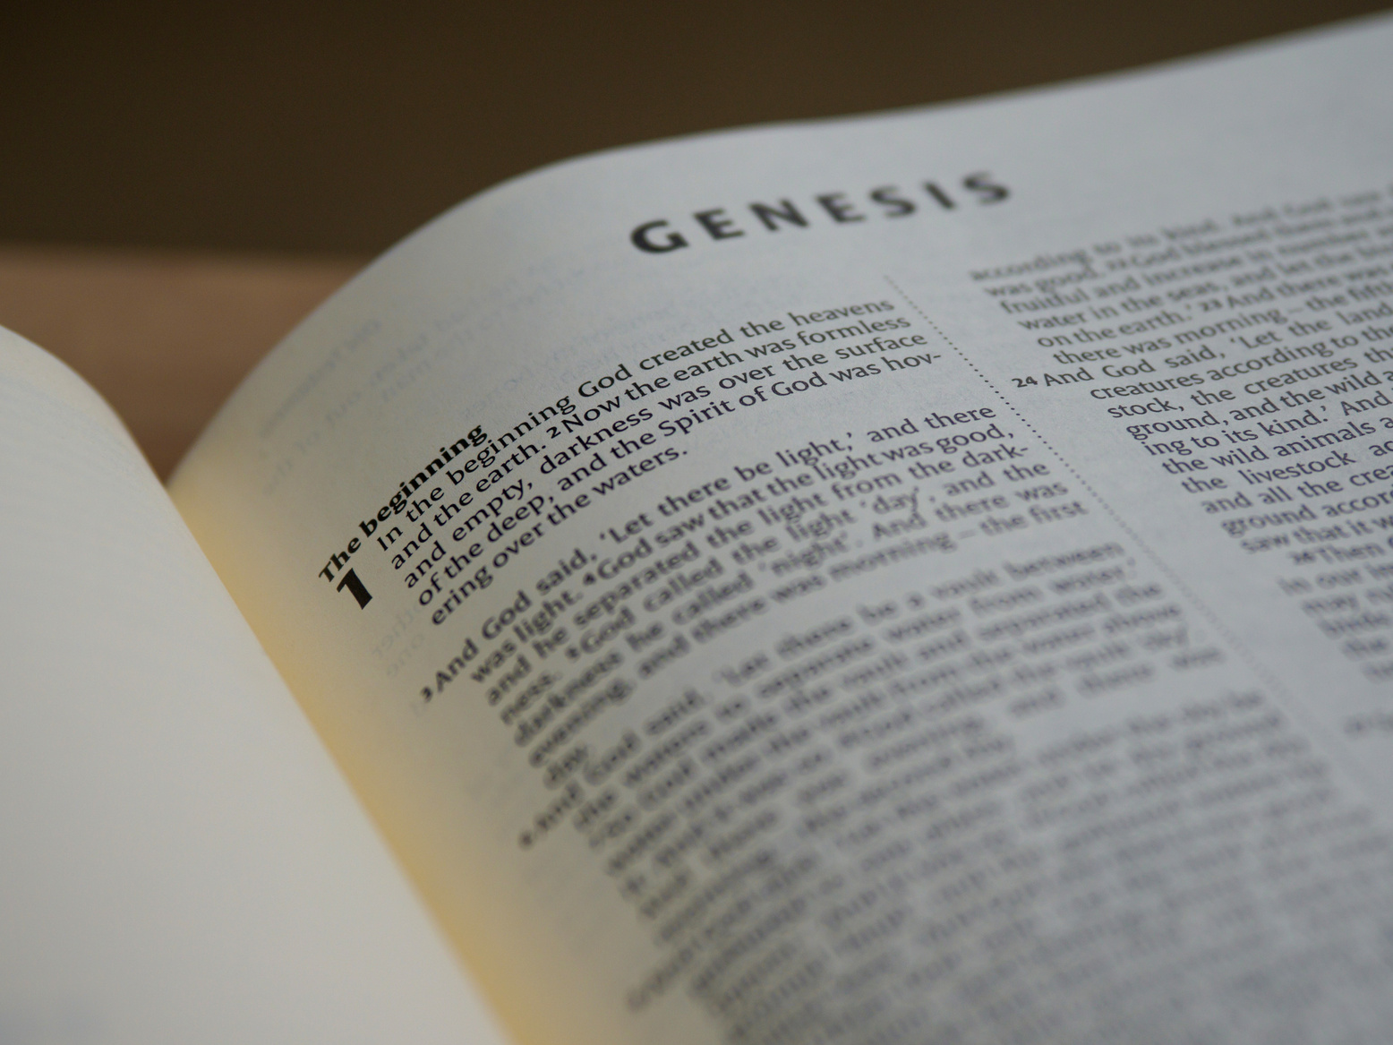



Practical Strategies
for Biblical Integration
Chris Belyeu
chbelyeu@oru.edu

Slide 2
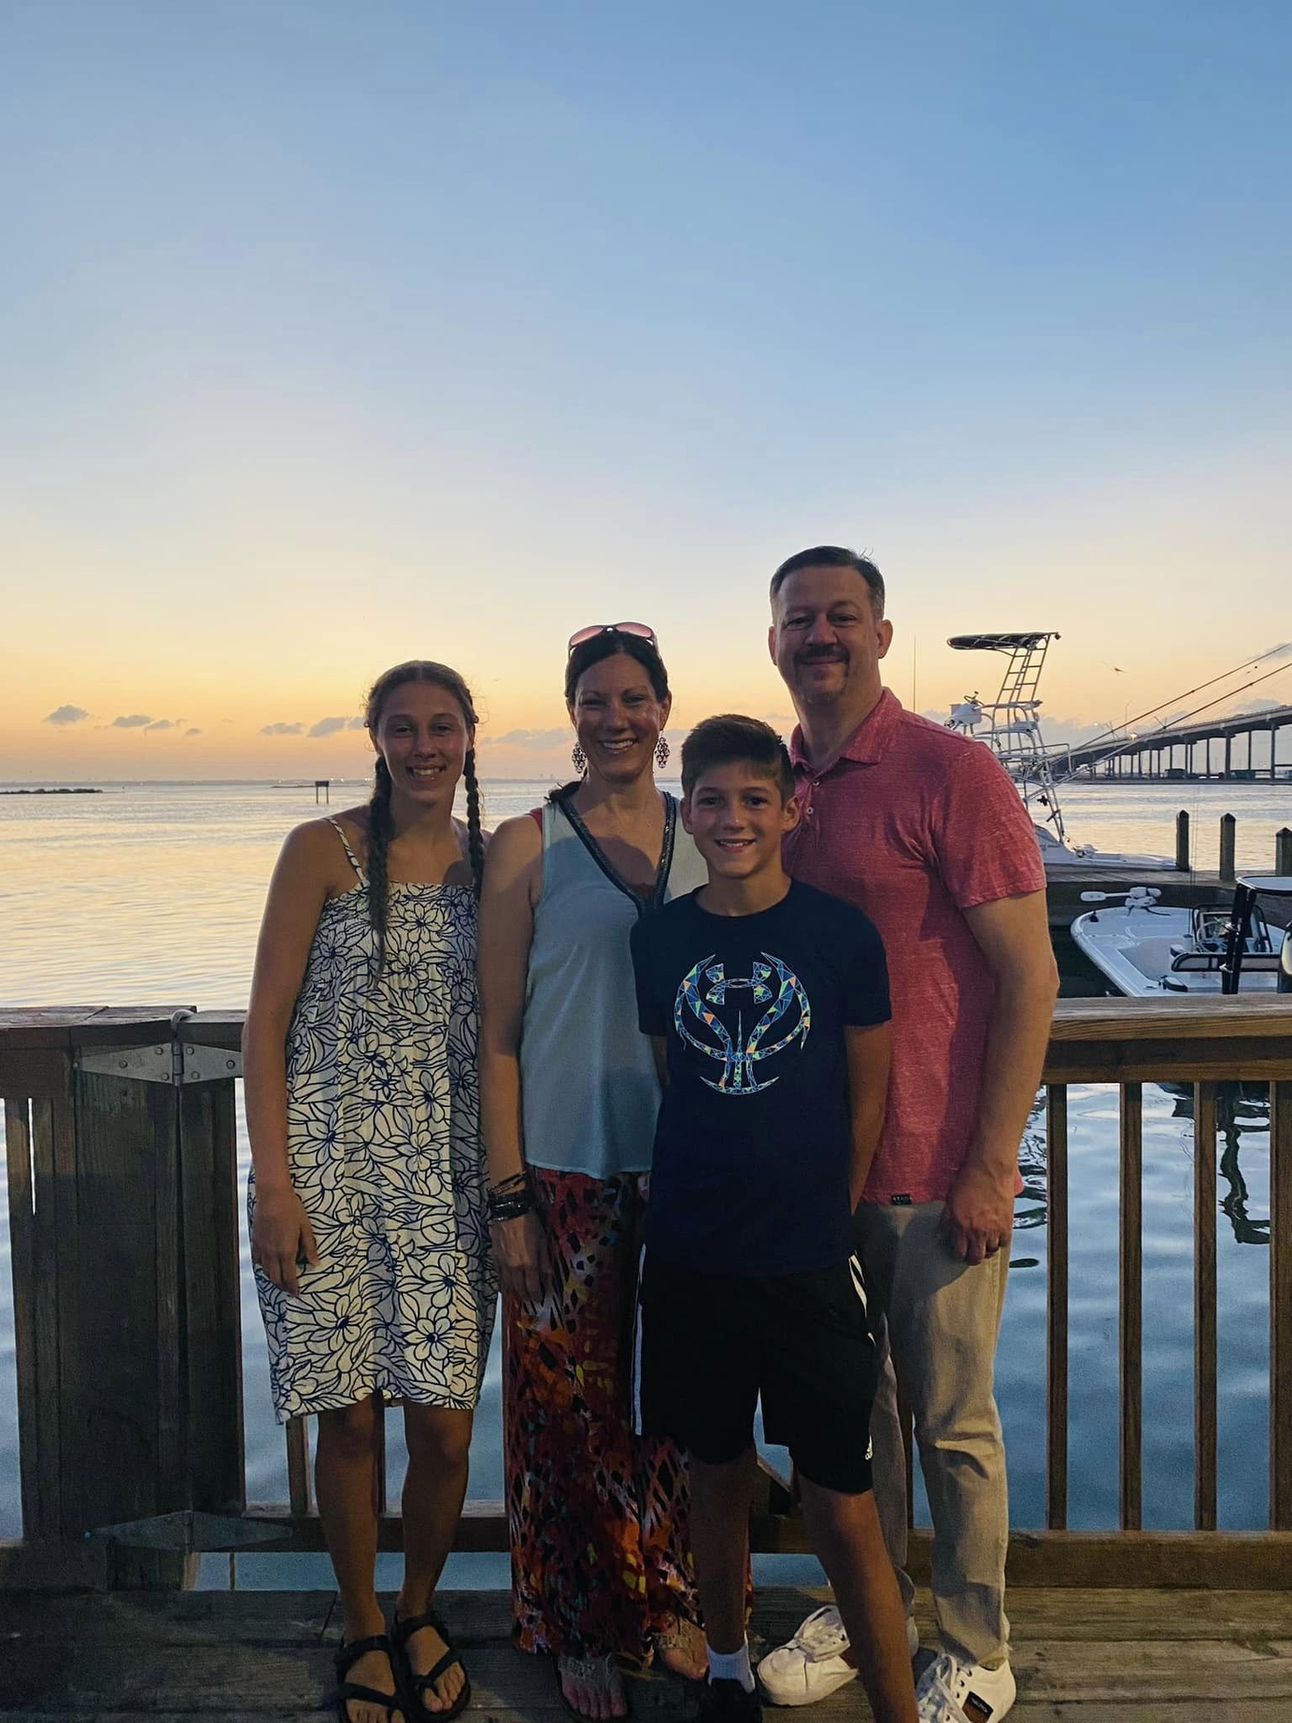
Notes:
I am always talking about my family when I travel, and I wanted to make sure that you know they are real. This is my wife Chrissie, my daughter grace (18), and my son (12).

Slide 3

Setting a Foundation
If you take away enough truth, the tower that has been built will eventually collapse.
Notes:
In my family, we love to play board games together. When we play together, we grow together. Our only problem is that we are all very competitive. None of us likes to lose! When the children were younger, it was easier to win. Some moms and dads in the room love to let their children win. I was not one of those dads. I wanted them to learn the art of winning AND the grace of losing. I don't know if that happened exactly as I wanted. Of course, now it isn't quite as easy to win.
One game we enjoy is Jenga. Maybe you have played it before. You build a solid structure, alternating three bricks on top of three other bricks. Then each player takes a turn pulling one of the bricks out until the structure falls. Whoever pulls the brick out before it falls is the loser.
I was looking at this Jenga structure one day and started thinking about the work we do with Biblical worldview development in students. If we build a structure with truth (line upon line and precept upon precept - Isaiah 28:10), it becomes a solid foundation for our students to live our their Christian faith. But if we begin to distort truth or remove truth, little by little, the tower will come tumbling down.
The work we do in building our students' worldview to reflect a knowledge of God's Word and a relationship with Him, is critical, no imperative, to setting a foundation for their lives. Jesus talked about how a wise man builds his house upon a rock, but the foolish man builds his house upon the sand. We can't control where the student builds the house, but we can provide the building materials that they can use for today and for the rest of their lives.

Slide 4

What is worldview?
  A set of basic beliefs, assumptions, and values
  Which arises from a big story and
  Produces individual and group action in human culture
Notes:
I'm sure today is not the first time that you have sat in a session to learn about worldview. I have seen several definitions of worldview and a lot of them are great.
Today, we are going to use this definition that is used by Dr. Bryan Smith, the BJU Press guru on worldview. (read)
For the rest of the session we are going to focus on these three parts: values, the big story, and how we can act on these ideas.

Slide 5


A Model
Math
Bible
Reading
Phys Ed
Fine Arts
Science
Social
Studies
Notes:
I think many teachers when they begin teaching in a Christian school view Biblical integration in this model.
They see that each subject as a separate subject, including Bible. In this model, Bible is introduced as a separate subject, taught every day, helping students understand God's Word. Chapels and campus pastors are implemented to help disciple students as well. Teachers' content is focused on "academic" materials and Bible teachers focus on "spiritual" materials.
This is certainly an improvement over a public educational institution, but the danger is that it can create a mindset of dualism. Dualism places things in their compartments. God's Word wasn't written just for our Bible instruction. It contains truth that is reflected in all subjects.

Slide 6

A Different
Model
Bible
Math
Phys Ed
Reading
Fine Arts
Science
Social
Studies
Notes:
I would like to present this model. In this model, we teach the Bible and through the lens of God's Word. The Bible is the foundation of all of the material content: the values, big story, and applications all reflect the truth of God's Word.

Slide 7
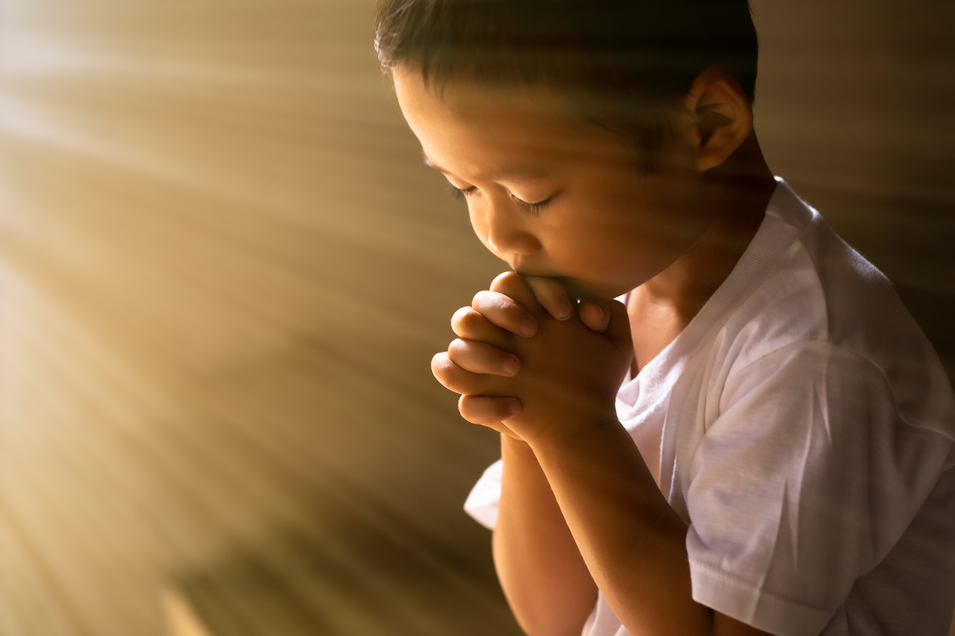
Beliefs, Values, and Assumptions
Notes:
I have seen many Christian school teachers work diligently to search for a scripture that they can present in each lesson. Administrators or directors require "Biblical Worldview Objectives" in each lesson. I appreciate this effort, because it shows that the school is being intentional in their efforts.
However, I am afraid creating "content objectives" and separate "Biblical worldview objectives" also promotes dualism. Students can discern the difference between when an application feels natural or if it feels artificial.
I encourage you to look at your subject from the perspective of beliefs, values, and assumptions. In the subject content, what are the basic beliefs that are necessary for a student to understand to draw Biblical conclusions? What are the values that need to be in place to feel the spiritual connection? And what are the assumptions that you need to make sure students can apply to the content that you are teaching?
For instance, in science, we can build the belief that God created our world in 6 days and on the 7th day he rested. When I assume that God created the world around me, and gave order to His creation, my focus becomes on discovery and mastery of His creation. If I have an evolutionary assumption, my value is that I am trying to evolve into a higher version than the past versions of humanity.

Slide 8
What are the 5-10 most critical beliefs, values, and assumptions that are important for students to understand about your subject in general?
Notes:
I want us to do a little bit of sharing with each other.
One of the important things to do is to look at the big picture of your subject content. Start here. What are the biggest Biblical values for that subject that need to be communicated.
Let's turn to one or two people around you, let them know what subject and grade level you want to share about. Then brainstorm about the 5-10 most critical beliefs, values and assumptions for students to understand about your subject.
Do this quickly and write them down.

Slide 9
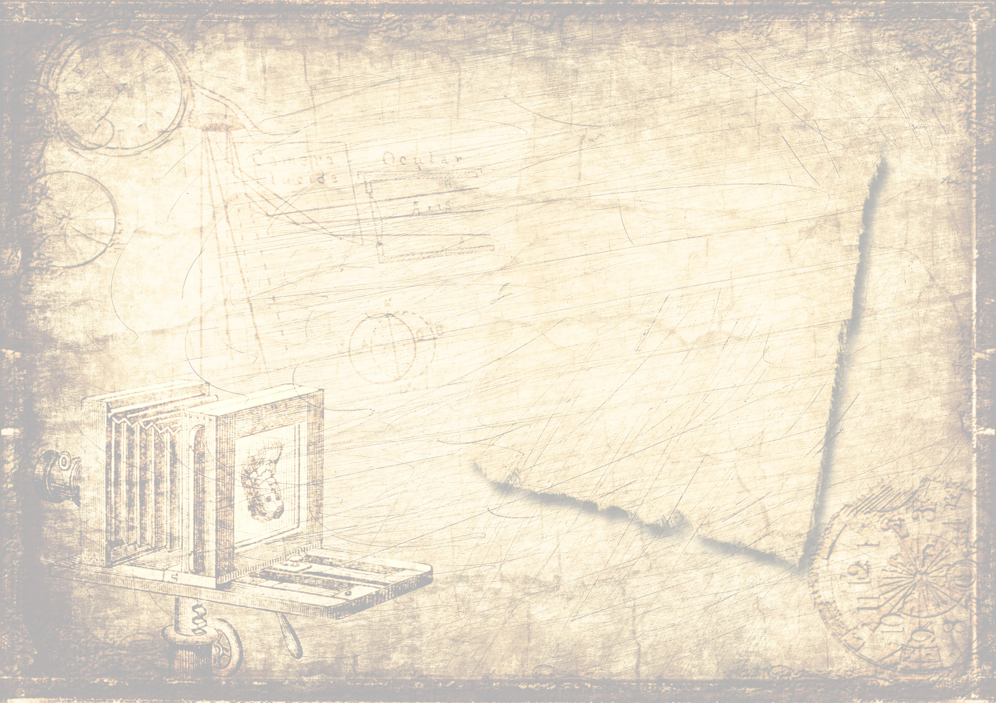
History
  God wants us to know history, so He had people write a record of it in His Word.
  God expects us to learn and do better with our knowledge of history.
  God has a plan that He is carrying to completion, and history records the progress of that plan.
  God’s dealings in history show us what He is like.
  God holds believers responsible for aligning ourselves with His plan.
  God deals with individuals as well as nations, holding both accountable.
  God frequently reveals things about past/future to His servants.
Notes:
I wanted to share some of the things that I have reflected on for a couple of subjects.

Slide 10

Science
  The Bible and the findings of science do not conflict.
  God is the Creator who made the earth for our enjoyment and His glory.
  God preserves His creation so that it continues to function as He planned.
  God uses His creation, what we observe in nature, to teach eternal truths.
  God’s creation was perfect in the beginning, but His creation was affected by man’s sin.
  God has provided an orderly world that He wants us to learn and subdue.
  Men by nature are not neutral or objective observers of God’s universe; man’s ability to understand truth is impaired by sin.

Slide 11

Music
  Music is characteristic of heaven.
  Music is God’s gift to us.
  Music appeared early in the history of man and has been an important part of every known culture.
  The major Scriptural function of music is to praise and worship God.
  Music is a method of communicating with one another.
  Music can be inspired by God, by man, or by the devil.
  We are instructed to be skillful in the making of music.

Slide 12

Big Story
Metanarrative
Notes:
Now, you take your most critical beliefs, values and assumptions and frame them in the metanarrative or big story of the Bible.
The Bible is one big story. From the beginning of the book when God spoke, "Let there be light!" and place Adam and Eve in the Garden of Eden to the end of the book when God restores the perfection of Eden in heaven.
The big story of the Bible is that God created the world perfect. Sin entered the world through mankind's disobedience. But God has a plan to redeem and restore mankind to Himself. BJU Press has called this the Creation, Fall, Redemption Model.

Slide 13

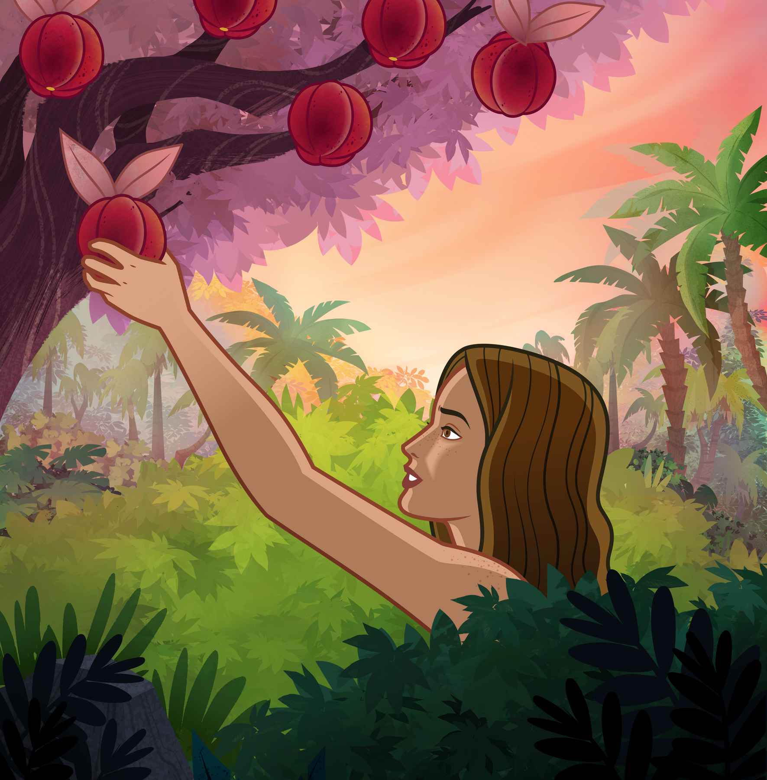
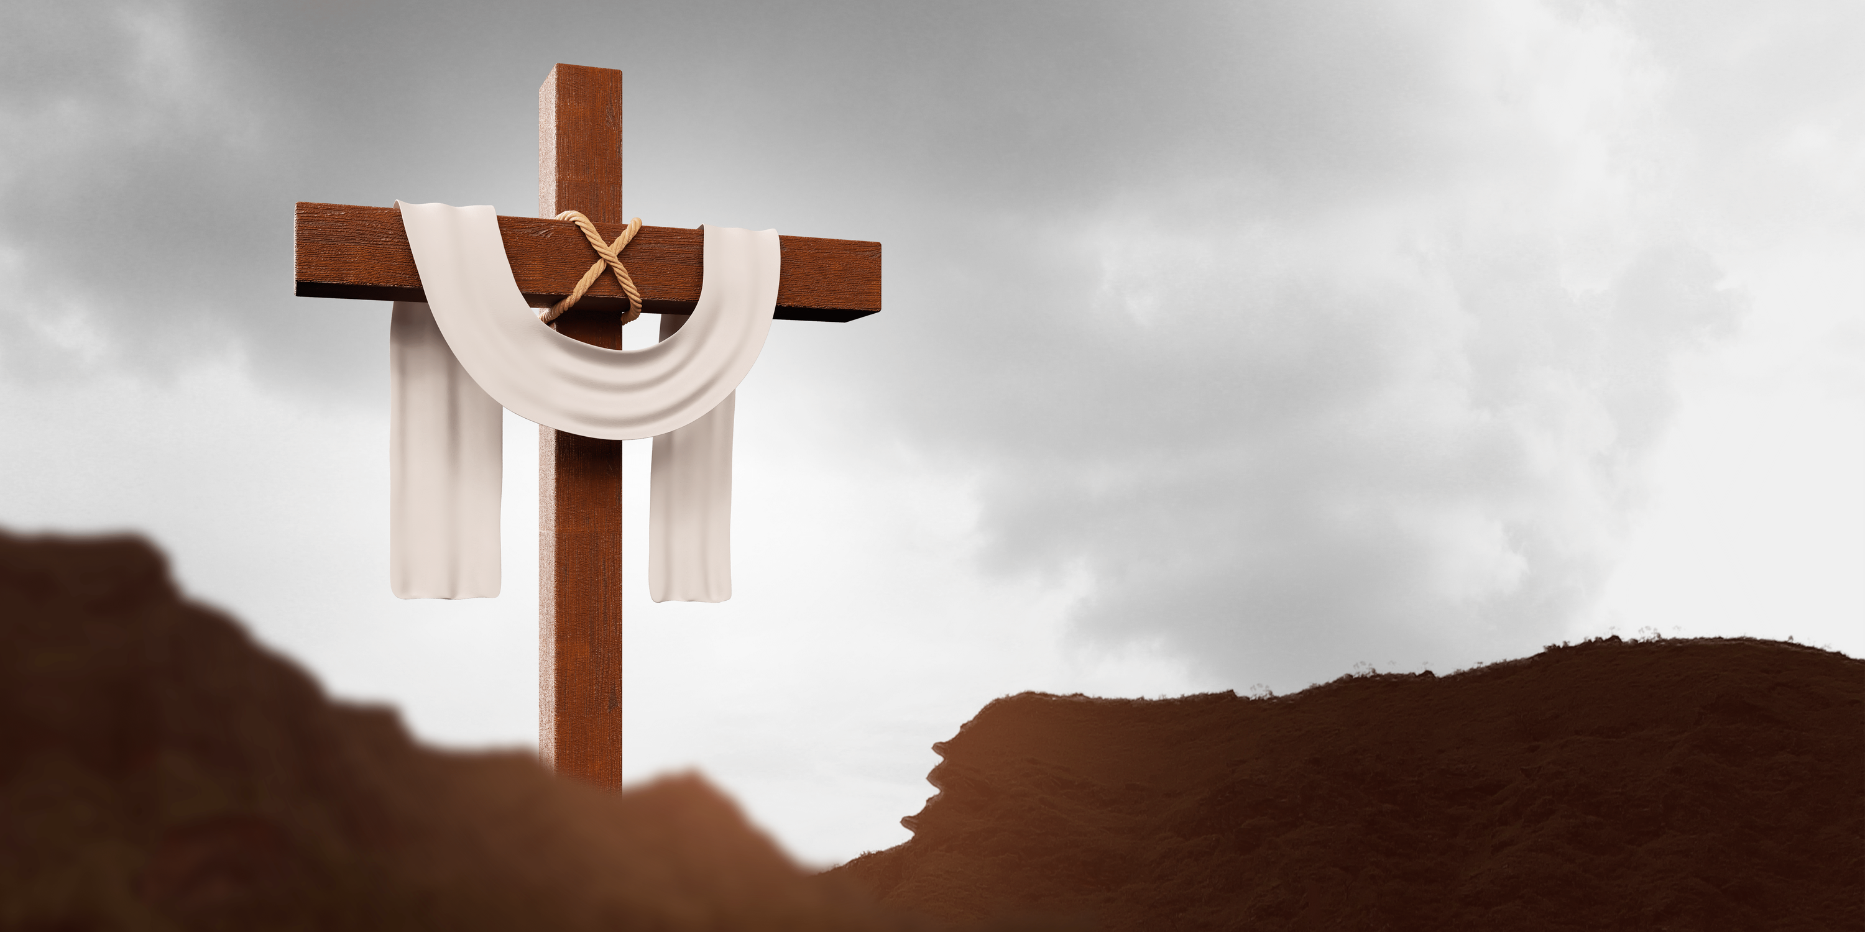
Creation
Fall
Redemption
Notes:
Whether we are looking at our subject content, the relationships we have with our coworkers, student discipline, assessment, teacher evaluations, etc. All of these things are reflective of Creation, Fall, Redemption.
Everything that happens throughout God's word, history, and our lives starts on the stage of creation: marriage, government, agriculture, engineering, technology, theatre, and the list goes on. God reveals Himself in all of these areas. The Bible isn't the only thing, but it is the lens. Creation gives us the glasses. It helps us see the baseline normative. I encourage you to not just look at the glasses, but to put them on!
Then came the Fall. While creation created the baseline normative, the Fall of man created distortions. It is like creation is a straight pole, but when Adam and Eve sinned by eating from the tree of knowledge of good and evil, the pole began to bend. It is the same pole, but it is bent. Most people see the current bent pole and think that it is normal. This is why we have to look at God's word to discern what is normal and what is fallen. We have to train students to recognize truth in the midst of distortions. We have to prepare them to go into the world and deal with the problems (straighten the pole), not run away from problems. The Fall of man brought a curse with it...
Creation took the God of the universe a week. The fall only took man an afternoon to mess it all up. Redemption is the process between then and Revelation 22. Redemption is where we live. Praise God for the Cross! Praise God that death, hell, and the grave could not hold Jesus! Praise God that we have hope!
While Eve and Adam stole the fruit from the tree, Jesus hung on a tree to die. He was undoing what the Fall did in the beginning. His hands were pierced because our hands stole from the tree. His feet were pierced because the first Messianic prophecy in Genesis 3:15 was "Thou shalt bruise his heel." His side was pierced because Eve came from the side of Adam, making atonement for Eve who led Adam into temptation. A crown of thorns was placed on His head because He was redeeming the ground that produces thorns and thistles as a result of the curse. He was literally taking the curse on His head to reverse it and to restore the blessing. Yes! We messed it up, but God always has a plan. You and I are a part of that plan. Every student in your classroom is a part of that plan! Hallelujah!
When Jesus preached His sermon on the Mount in Matthew 5-7, he was helping people understand the Creation pole that we were talking about. He was helping us understand that the way we look at things isn't correct. He said things like, "You have heard it said, but I say..." When the wind and waves threw themselves at Him, He was restoring the earth when He said, "Peace be still." When He healed the sick, He was helping us see that sickness and disease is a bent pole. He restores health.
Redemption is about restoration. We are not sending our students into a world of Revelation 22. They are going into a world where there is still a conflict. It is the conflict between, Thy Kingdom come, Thy will be done on earth as it is in heaven. The cross is the adjustment. The cross takes the broken, bent pole of fallen "truth" and restores you. As born-again Christians, our minds are being transformed by His Word until Revelation 22:5, "There shall be no night there; and they need no candle, neither the light of the sun; for the Lord God will give them light." And once again we will be restored to our place of ruling and raining, but this time for forever.
We won't have to look through a glass dimly anymore, we will see clearly as He sees.
This is a great story and it affect everything brothers and sisters! When you are dealing with discipline, it is about repentance through the cross to restore a child through redemption and restoration. It isn't about getting through your lesson or disrupting other students. Discipline is about helping that child understand that the pole is bent and it needs to be aligned to the Cross!

Slide 14

Align Your Own Worldview
Notes:
The next strategy that I want to talk about is how we must be diligent to align our own worldview to God's Word. One thing that I have learned about myself through the years is that God is constantly making adjustments in my mind and heart. I thought I had things figured out when I was 18. When I was 22 I was telling people how they should be doing things, but through the years, over and over, God has been realigning me to His Word. Things I thought I understood, I needed more revelation on.
We will not be finished realigning the pole on this side of eternity. Cultivate your relationship with Him every day. Let yourself hear the encouraging words, but also open your hearts to hear when He speaks correction and realignment to you. (Grace about boyfriend in the prayer closet)
We can't give something we don't have.

Slide 15
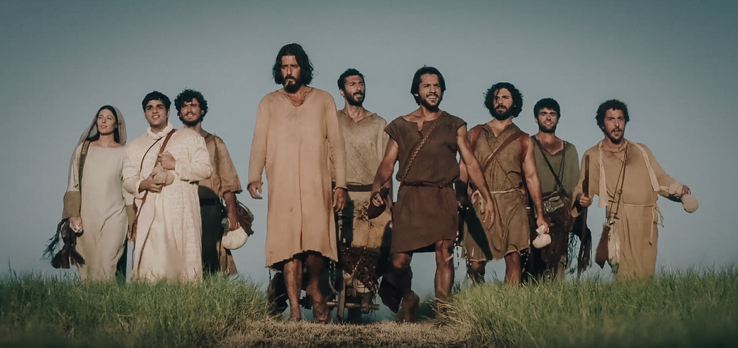
Making Disciples
To make disciples, we must first be disciples.
What qualifies someone to be a disciple?
  They obey His teachings.
  They love other followers of Christ and the lost.
  They produce spiritual fruit.
  Placed God first in surrender.
Notes:
To make disciples, we must first be disciples. If we look at the teachings that Jesus gave for His disciples, He qualified disciples in these four ways.
1. We must obey His teachings. That means we have to read His Word daily to know what He teaches.
2. Disciples love other followers of Christ and they love the lost. This is a powerful reflection point. What does my love toward others look like. It has to look like something. I can't just assume my wife knows that I love her. I have to tell her, and I have to show her. Love looks like patience. It looks like kindness. It doesn't put yourself above others. When you love, you don't get angry easily because forgiveness is always at work, because you were first forgiven. When you love someone, you protect them, you trust them, you hope good things for them, and you are committed to persevere with them.
Thirdly, disciples produce spiritual fruit. Look at the health of your life. What seeds are you sowing? Are those seeds bearing fruit in their season? If you don't see any fruit around you, press into Jesus.
Finally, a disciple always places God first in surrender. We follow in Jesus' footsteps and say, "Not my will but Your will be done." We say, "I am crucified in Christ and it is no longer I who live, but Christ who lives in me" and through me. God, I don't just stay kneeling at the foot of the cross. I actually stand behind the cross and allow the cross to be what people see in me. I just want them to see Jesus.

Slide 16

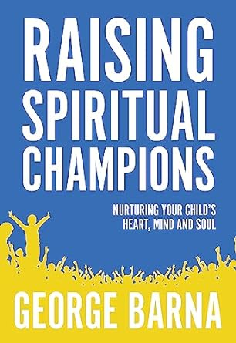

Notes:
We are all educators in the room and understand the value of reading. Of course we should be reading God's word to align our lives with His word, but I just wanted to share three books that I have been reading lately on this topic.
(Talk about Barna at our summer conference)

Slide 17

Build Intentional Time in Every Unit
Notes:
Make plans in every unit to implement the metanarrative and the key concepts that you identified earlier. Grow that list year after year as you build intentionality in every unit of your lesson planning.

Slide 18

Four Phases of Worldview Experience
Ages 1-12
Ages 13-24
Ages 25-59
Ages 60+
  Absorption
  Experimentation
  Establishment
  Integration
  Refinement
  Application
  Consistency
  Transmission
  Unconscious acceptance
  Reflection
  Reconsideration
  Recalibration
Notes:
If you were with us last year, you have seen this slide. We will just look at the first two slides today, because we want to focus on the children that we serve.

Slide 19
Absorbtion, Experimentation, and Establishment
What are some strategies that you can use to help children ages 1-12 to establish their worldview journey?

Slide 20
Some of my thoughts:
  Live your life as an example of a disciple. Be natural.
  Model Biblical social interactions.
  Read and study scripture so that what is in your mind and heart comes easily out of your mouth.
  Talk about your experiences with the Lord.
  Statements of Biblical worldview are assumed to be correct
  Provide examples to reinforce Biblical worldview concepts
  Provide opportunity for children to apply Biblical truths
  Build a strong knowledge of the Bible to provide a foundation from which they will draw truth

Slide 21
Integration, Refinement, and Application
What are some strategies that you can use to help children ages 13-24 to implement and refine their worldview journey?

Slide 22
Some of my thoughts:
  Discussions (biblicalintegration.com)
    Language Arts
      How does faith affect what the author wrote?
      How does faith affect how a reader understands a piece of literature
    Mathematics
      How do you calculate tithes? Why is tithing based on a percent rather than a flat rate? Who benefits from the percentage scale?
      Why is it important to set standards? (i.e. standard weights, standard grading scale, standards for right and wrong

Slide 23
Some of my thoughts:
  Solve social problems
    Do preachers and teachers need to be held to a higher standard? Why or why not? Develop a one page list of principles that help guide your decision.
    Jesus said, “The poor you will always have with you...” What is a disciple’s responsibility in loving the poor? If the Lord provided you with $--, how would you use it to accomplish this in your community and why?
    Depression and anxiety are significant problems today. Why are these problems increasing? Does the Bible provide answers concerning these issues of mental health?
  Group projects
  Do not make assumptions
Notes:
Tell story of Daniel as pastor - city commissioner - Director Community Center (providing food for homeless and those who make little money.

Slide 24

Assess Worldview at Every Unit

Slide 25
Inspect what you expect
Arizona Christian University Worldview Assessment (Dr. George Barna)
PEERS Test - Nehemiah Institute
(Politics, Economics, Education, Religion and Social Issues)

Slide 26


Levels of Biblical Worldview Integration
Level 3 - Rebuilding
Level 2 - Responding
Level 1 - Referencing
Level 0 - None

Slide 27
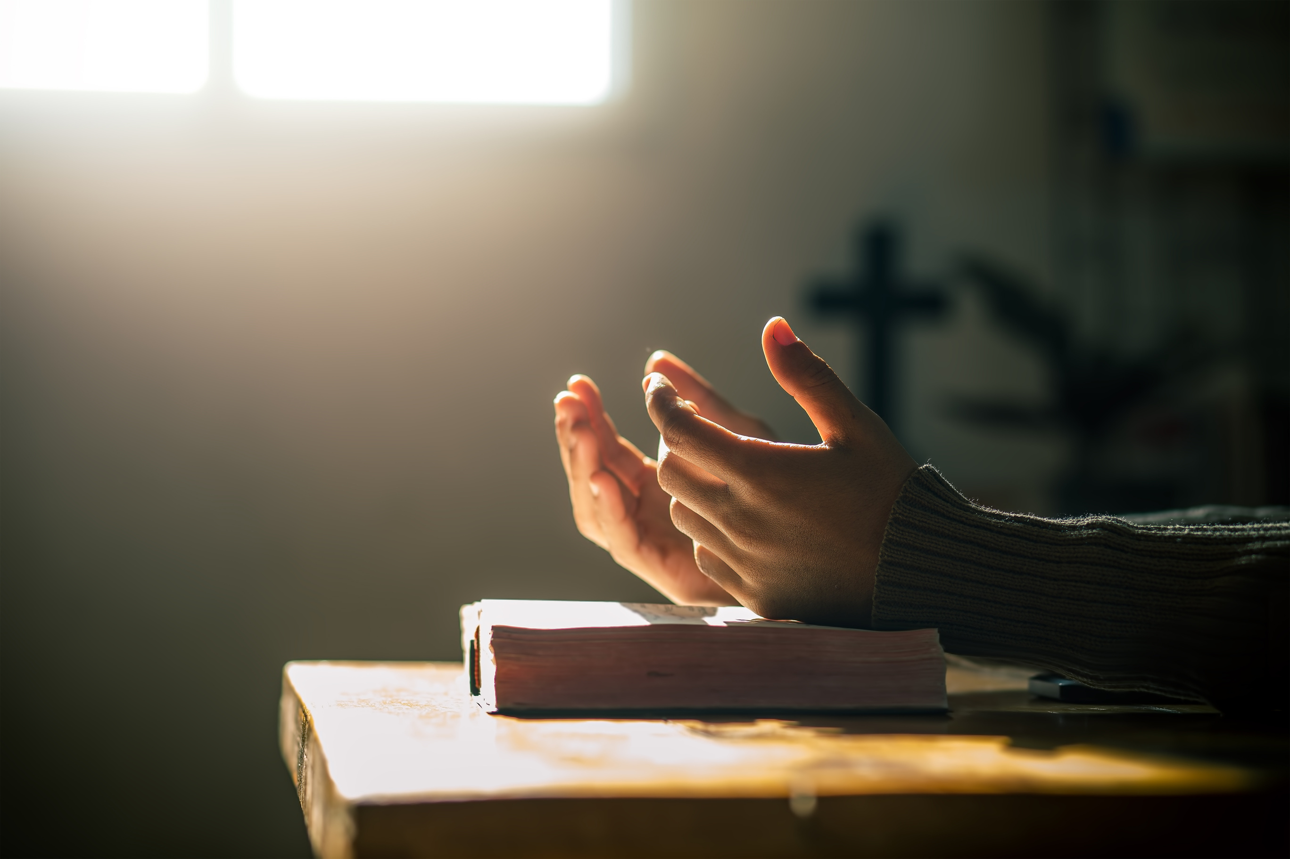
We can’t do this by ourselves.
  Collaborate with others
  Receive correction
  Recognize your dependence on the Holy Spirit
Notes:
Invite the Holy Spirit into your classroom. Prepare the atmosphere.
There is something that happens when I and my students encounter the presence of God. He can change things in one moment that would take a lifetime of teaching and instruction.

Slide 28

Thank You
For the Work You Do
Chris Belyeu
chbelyeu@oru.edu
Notes:
Encourage with seed and fruit.
Galatians 6:9 - Let us not become weary in doing good, for at the proper time we will reap a harvest if we do not give up.
Joining generations
We pray for you in the ORUef and ICAA offices often. Our OBED family is doing great work in the nation of Colombia. I tell other nations about your Kingdom focus.

