Slide 1
A Biblical Model of Discipline
Donnie Peal, Ed.D.
Executive Director
ORUEF/ICAA

Slide 2
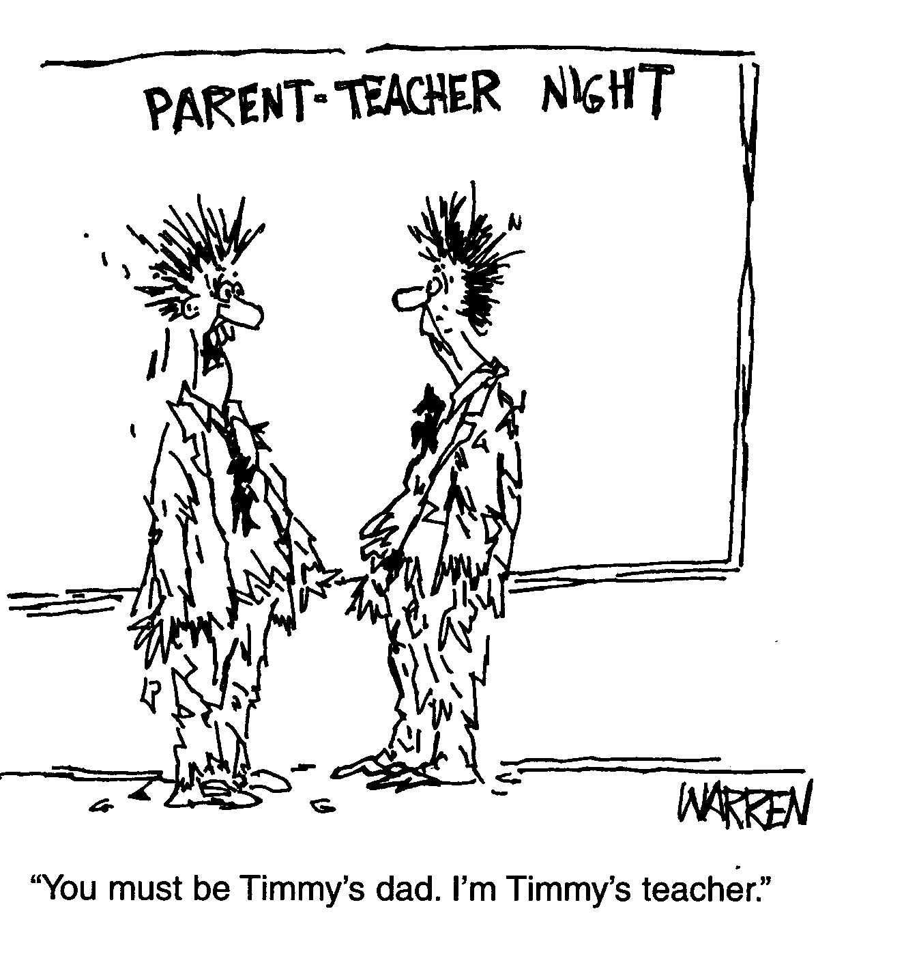
2

Slide 3
Activity – General Discussion
What makes your school a Christian school?

Slide 4
Beware lest anyone cheat you through philosophy and empty deceit, according to the tradition of men, according to the basic principles of the world, and not according to Christ. Colossians 2:8
4

Slide 5
Foundational Emphases of Christian School Education
5
Instilling a Christian worldview
Forming Christian character
Developing a heart of Christian service
Notes:
Illustration of acorns
Every student has a God-given purpose and destiny
One’s greatest joy and fulfillment in life is found in discovering that purpose and destiny and completing it.

Slide 6
Any education that is not Christian is not education; it is propaganda. Cal Thomas Nationally Syndicated Columnist USA
6

Slide 7
Discipline is …
…instruction that molds, shapes, corrects, and inspires appropriate behavior – involves both positive and negative motivators for appropriate behavior.

Slide 8
Activity – Group Discussion
What are some types of situations in which you would expect to provide discipline to a student?

Slide 9
When Do You Discipline?
When a rule is broken
When learning is about to be interrupted
When, if not corrected, a bad situation could arise
When someone could get hurt
When property could be damaged

Slide 10
2 Major Causes of Discipline Problems
Lack of Understanding
Folly brings joy to one who has no sense, but whoever has understanding keeps a straight course.
Proverbs 15:21

Slide 11
2 Major Causes of Discipline Problems
Lack of Understanding – Proverbs 15:21
Lack of Supervision
…a child left to himself brings shame to his mother
Proverbs 29:15

Slide 12
3 Types of Rule-Breakers
The Simple – Proverbs 7:7
I saw among the simple, I perceived among the youths, a young man devoid of understanding.
The Foolish – Proverbs 2:15
Foolishness is bound up in the heart of a child; the rod of correction will drive it far from him.
The Scorner – Proverbs 22:10
Cast out the scorner, and contention will leave; yes, strife and reproach will cease.

Slide 13
Principles of Biblical Discipline
Correction
Provide Understanding
Supervise, Supervise, Supervise
Enforce the Rule or Don’t Have the Rule – Proverbs 23:13

Slide 14
Do not withhold correction from a child.. Proverbs 23:13a The spirit of man is the lamp of the Lord, searching all the inner depths of his heart. Proverbs 20:27

Slide 15
Principles of Biblical Discipline
Correction
Provide Understanding
Supervise, Supervise, Supervise
Enforce the Rule or Don’t Have the Rule – Proverbs 23:13
Require First-Time Obedience – Proverbs 13:24

Slide 16
He who spares the his rod hates his son, but he who loves him disciplines him promptly. Proverbs 13:24
16

Slide 17
Principles of Biblical Discipline
Correction
Provide Understanding
Supervise, Supervise, Supervise
Enforce the Rule or Don’t Have the Rule – Proverbs 23:13
Require First-Time Obedience – Proverbs 13:24
Be Consistent – Proverbs 24:23b; Proverbs 24:6

Slide 18
Consistency in your own classroom …it is not good to show partiality in judgment. Proverbs 24:23b Consistency throughout the school For by wise counsel you will wage your own war and in the multitude of counselors there is safety. Proverbs 24:6

Slide 19
Principles of Biblical Discipline
Make the Consequences Suitable to the Offense – Proverbs 25:11-12

Slide 20
A word fitly spoken is like apples of gold in settings of silver. By the severity of the consequences like an earring of fine gold is a wise rebuke to an obedient ear. Proverbs 25:13-14

Slide 21
Principles of Biblical Discipline
Make the Consequences Suitable to the Offense – Proverbs 25:11-12
Correct Attitudes as well as Actions – Matthew 12:34b; Proverbs 27:19

Slide 22
…for out of the abundance of the heart the mouth speaks. Matthew 12:34b As in water face reflects face, so a man’s heart reveals the man. Proverbs 27:19

Slide 23
Principles of Biblical Discipline
Make the Consequences Suitable to the Offense – Proverbs 25:11-12
Correct Attitudes as well as Actions – Matthew 12:34b; Proverbs 27:19
Guard Your Emotions – Proverbs 25:28; Proverbs 2:24-25

Slide 24
He who has no rule over his own spirit is like a city broken down without walls Matthew 12:34b Make no friendship with an angry man, and with a furious man do not go, lest you learn his ways and set a snare for your soul. Proverbs 27:19

Slide 25
Principles of Biblical Discipline
Make the Consequences Suitable to the Offense – Proverbs 25:11-12
Correct Attitudes as well as Actions – Matthew 12:34b; Proverbs 27:19
Guard Your Emotions – Proverbs 25:28; Proverbs 2:24-25
Administer Grace When Appropriate – Proverbs 28:13

Slide 26
He who covers his sins will not prosper, but whoever confesses and forsakes them will have mercy. Proverbs 24:23b

Slide 27
If we work upon marble, it will perish. If we work upon brass, time will efface it. If we rear temples, they will crumble to dust.
But if we work upon men's immortal minds, if we imbue them with high principles, with the just fear of God and love of their fellow men we engrave on those tablets something which no time can efface, and which will brighten and brighten to all eternity.
Daniel Webster, 1852
American Statesman
27
Notes:
Recognizing the importance of raising children in the training and instruction of the Lord, the statesman Daniel Webster said:

